Slide 1
Predictive Maintenance of Industrial Machinery
CAPSTONE PROJECT
Presented By:
Shubham Chaturvedi – GL Bajaj Group of Institutions – CSE
Github - Shubham-Chaturvedi-23/IBM-AICTE-Internship

Slide 2
OUTLINE
Problem Statement
Proposed System/Solution
System Development Approach
Algorithm & Deployment
Result
Conclusion
Future Scope
References

Slide 3
Problem Statement
Modern industries rely heavily on a fleet of complex machines for production. Unexpected machine failures lead to increased downtime, higher maintenance costs, and reduced productivity.
There is a critical need to predict machinery failures in advance so that proactive maintenance can be scheduled, minimizing disruptions. This project focuses on leveraging real-time sensor data from industrial machines to identify patterns that precede failures.
The ultimate aim is to develop a robust classification model that can automatically predict the type of failure (such as tool wear, power outages, or overheating) and enable timely, cost-effective maintenance.

Slide 4
Proposed Solution
Our proposed system offers a predictive maintenance solution for industrial machinery using machine learning and real-time sensor analytics. The system aims to:
Collect and analyze vast amounts of sensor data from machinery (e.g., vibration, temperature, current, pressure).
Identify and learn the critical patterns or signatures that typically precede common machine failures.
Train a machine learning classification model to predict specific failure modes before they occur.
Integrate the model into a real-time monitoring dashboard via IBM Cloud Lite, triggering proactive maintenance notifications to reduce unplanned downtime and operational expenses.
Components:
Data Collection:
Aggregate machine sensor logs, operational records, and maintenance histories.
Data Preprocessing:
Clean, normalize, and engineer relevant features (e.g., rolling averages, thresholds, anomaly flags).
Model Building:
Implement robust machine learning algorithms for multi-class failure prediction using Auto AI.
Cloud-based Deployment:
Deploy the solution using IBM Cloud Lite (Watsonx.ai Studio, Object Storage, Runtime).
Performance Monitoring:
Evaluate live predictions and refine the model for accuracy and efficiency

Slide 5
System Approach
System Requirements:
Sensor-enabled industrial machines transmitting real-time operational data.
Access to IBM Cloud Lite for data storage, model training, and deployment
User interface for maintenance alerts and analytics.
Libraries Required:
Python
IBM Watsonx.ai Studio
IBM Cloud Storage
Workflow:
Sensor data ingestion and real-time storage (IBM Cloud Object Storage)
Data preprocessing and feature extraction in Python notebooks (Watsonx.ai Studio)
Model training and evaluation in AutoAI
Deployment as an online service for live

Slide 6
Algorithm & Deployment
Algorithm Selection:
The core of the predictive maintenance system is a Batched Tree Ensemble Classifier (ICNR specialization).
This algorithm is specifically chosen for its ability to handle high-dimensional industrial sensor data, efficiently manage batch processing, and yield robust, interpretable classification results.
Batched ensemble methods combine the predictive strength of multiple decision trees with specialized techniques for class imbalance and noise reduction
Data Input:
The prediction model leverages the following real-time sensor features, namely, Air temperature, Process temperature, Rotational speed, Torque, Tool Wear, Fault Type.
These features collectively capture the thermal, mechanical, and operational health of the machinery.
Training Process:
Model Training: The Batched Tree Ensemble Classifier (ICNR) is trained using labeled historical data. The process includes stratified cross-validation and hyperparameter tuning to optimize performance for imbalanced classes and noisy signals.
Evaluation: The model’s performance is assessed via standard metrics—accuracy, precision, recall, and F1-score.
Prediction & Deployment:
The final trained model is saved and promoted within IBM Watsonx.ai Studio.
Deployment is performed in an online (real-time) mode, enabling instant predictions for incoming machine data streams.
Sensor readings (air temperature, process temperature, rotational speed, torque, and tool wear) are input live into the deployed model.

Slide 7
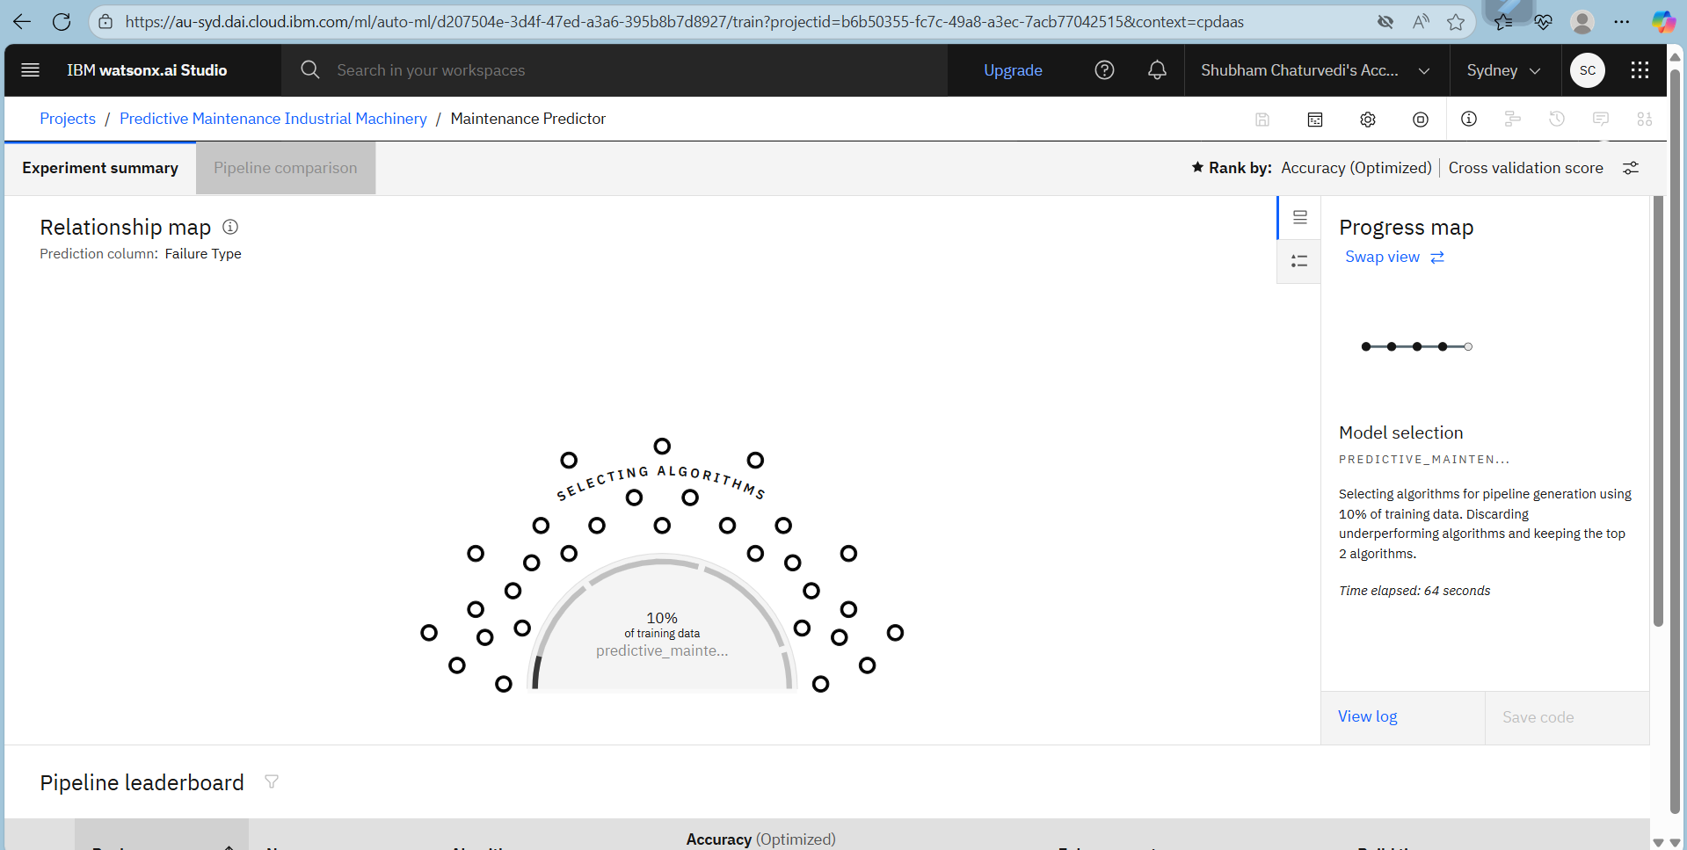
Result

Slide 8
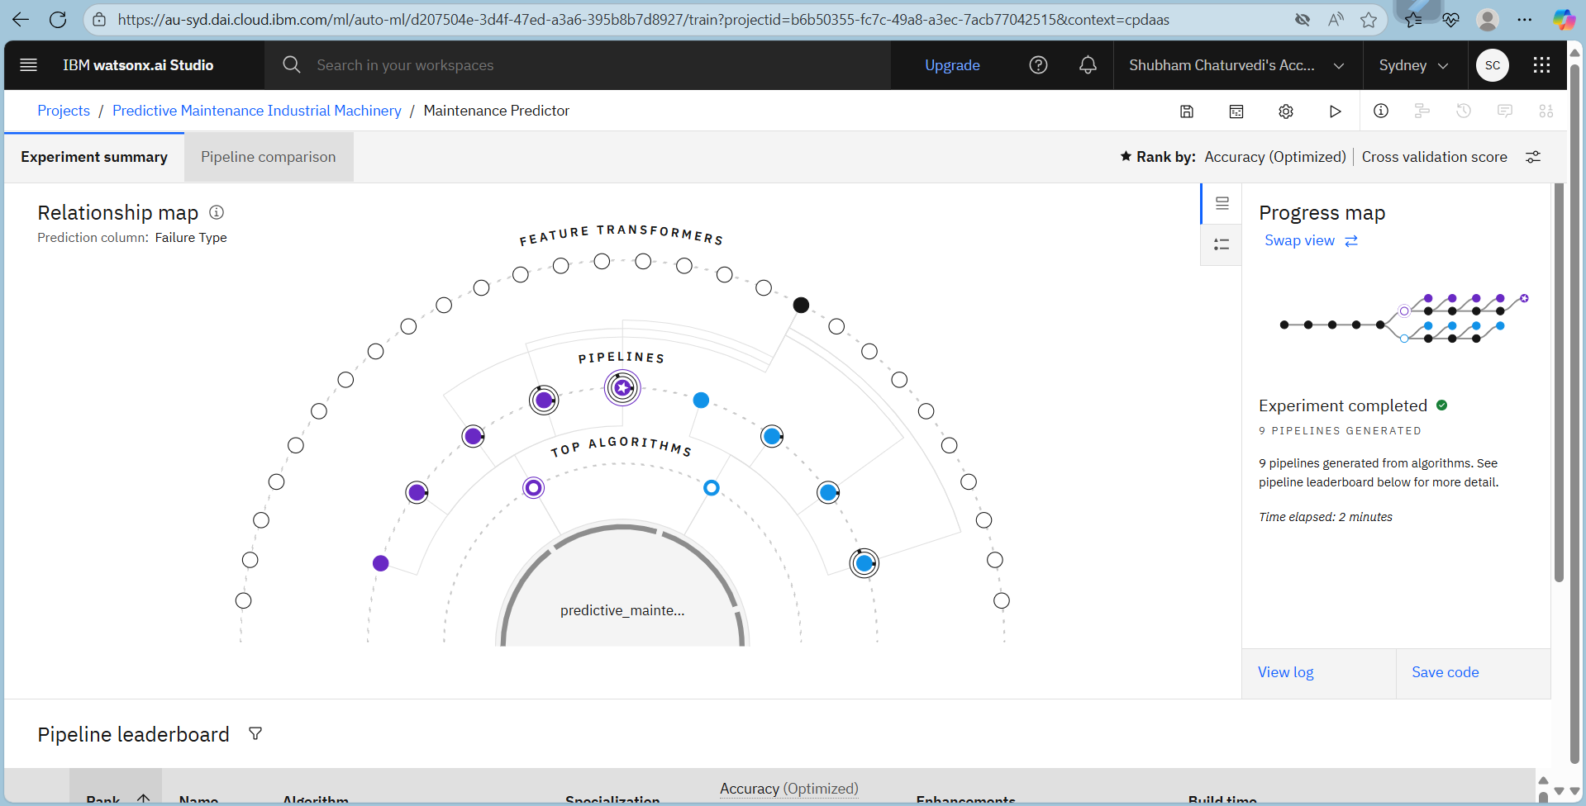
Result

Slide 9
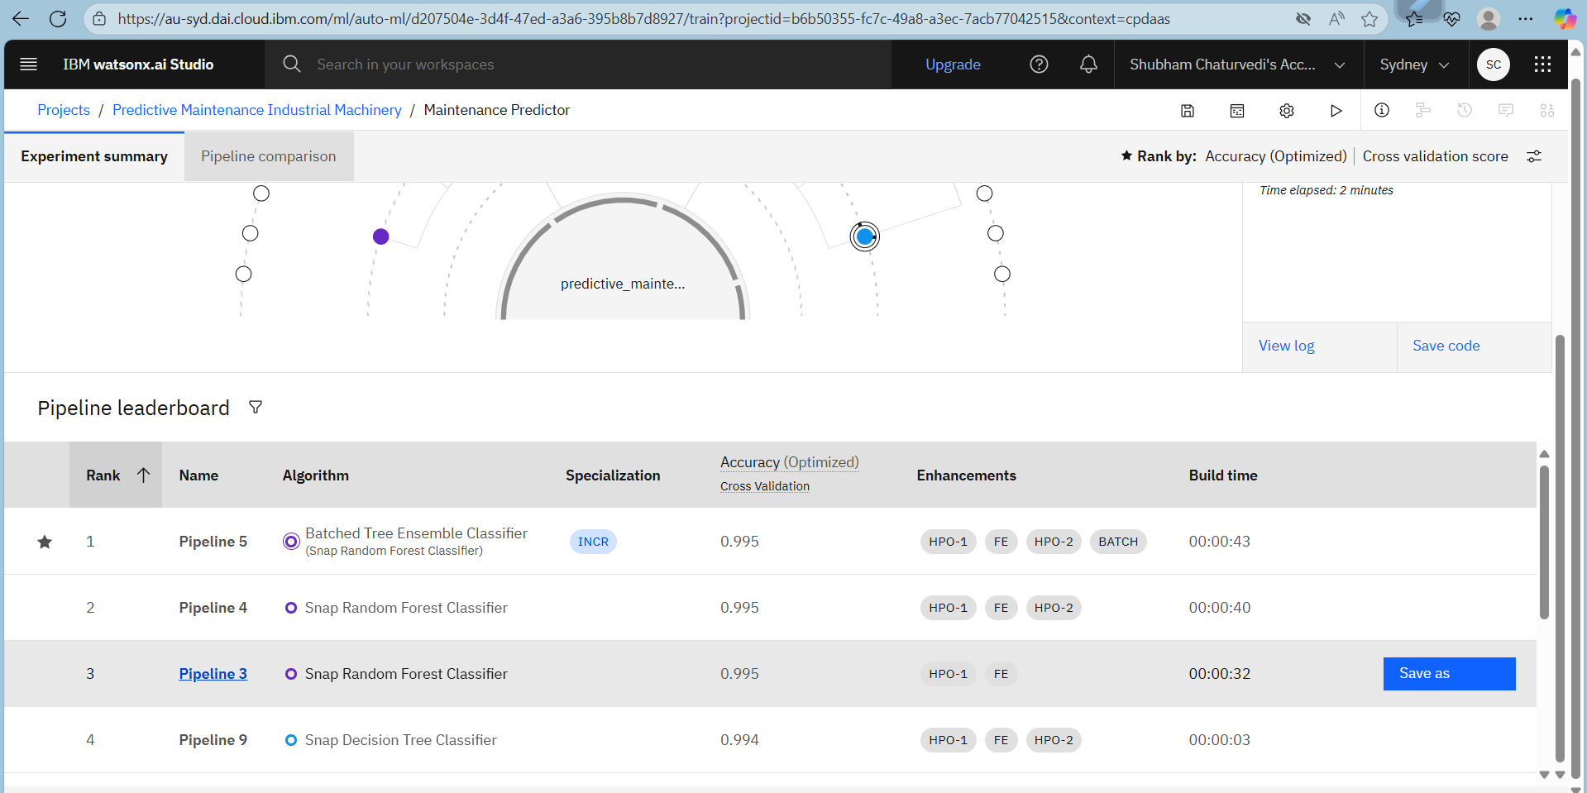
Result

Slide 10
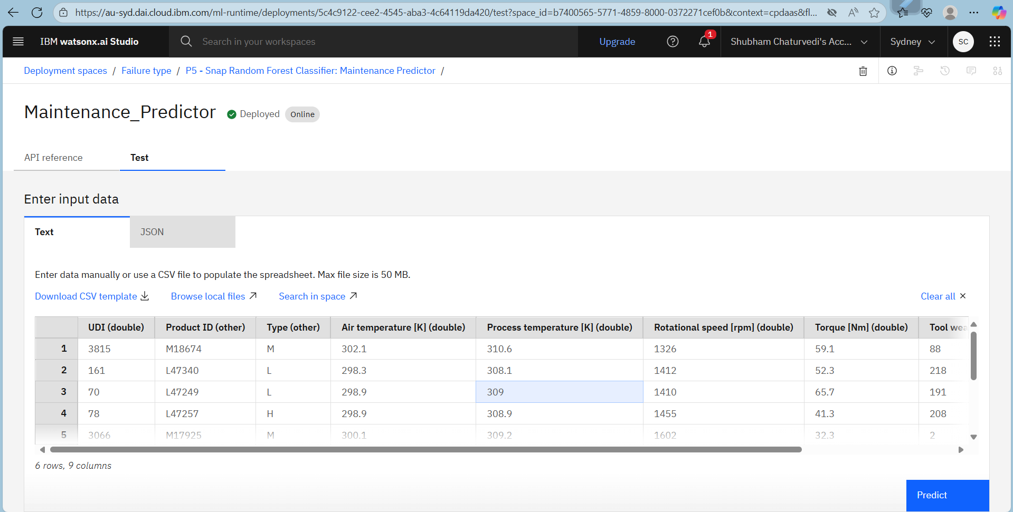
Result

Slide 11
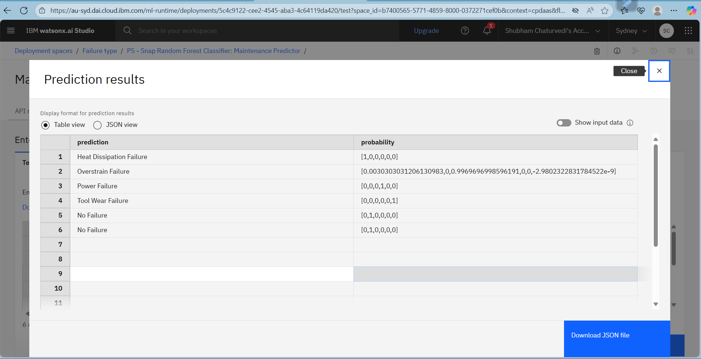
Result
The deployed predictive maintenance model achieves high cross validation accuracy of 99.5% in predicting machine failure types before they occur as per IBM Watson AutoAI pipeline leaderboard.

Slide 12
Conclusion
The predictive maintenance solution successfully demonstrates the power of machine learning in anticipating machine failures using real sensor data.
Deployment on IBM Cloud Lite ensures scalability, accessibility, and ease of integration within industrial environments.
The system enables industries to move from reactive to proactive maintenance, delivering measurable improvements in uptime and operational efficiency.
Continuous data collection and retraining further enhance accuracy over time.

Slide 13
Future scope
Expand sensor integration (add more sensor types and data sources).
Apply advanced algorithms (deep learning, anomaly detection, edge deployment).
Generalize the solution for other types of industrial equipment and processes.
Integration with enterprise maintenance management systems (CMMS).
Explore predictive maintenance at scale (multi-site, multi-factory deployments).
Use AI explainability tools to interpret failure causes and suggest specific maintenance actions.

Slide 14
References
Predictive Maintenance Classification Dataset Author: Shivam Bansal Source: Kaggle Link: https://www.kaggle.com/datasets/shivamb/machine-predictive-maintenance-classification
Application-Wise Review of Machine Learning-Based Predictive Maintenance Authors: Tsallis, C. et al. Journal: Applied Sciences, MDPI (2025) Link: https://www.mdpi.com/2076-3417/15/9/4898
A Review on Predictive Maintenance Using ML Techniques Authors: Jadhav, P. M. et al. Journal: IJCRT (2025) Link: https://ijcrt.org/papers/IJCRT2502697.pdf
Comparative Analysis of ML Algorithms for PdM Author: Bajaj, A. Source: IIP Series (2025) Link: https://www.iipseries.org/assets/docupload/rsl20251889AB5EB0B56CC.pdf
IBM Watsonx.ai Documentation Source: IBM Cloud Docs Link: https://www.ibm.com/cloud/watsonx-ai

Slide 15
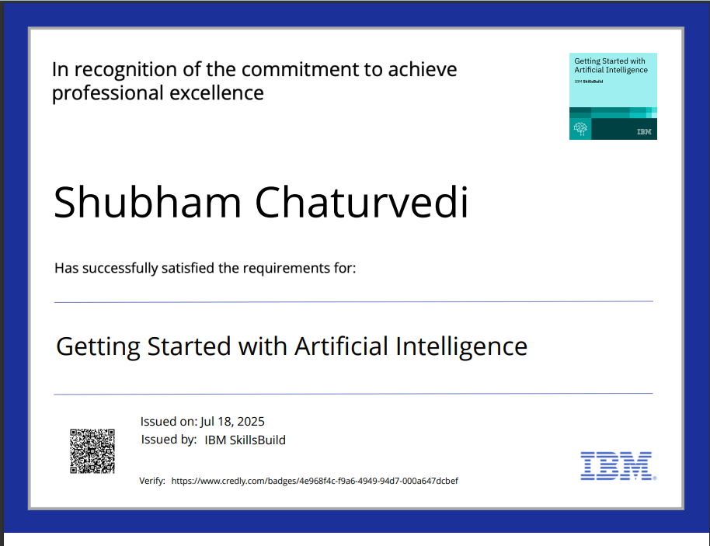
IBM Certifications

Slide 16
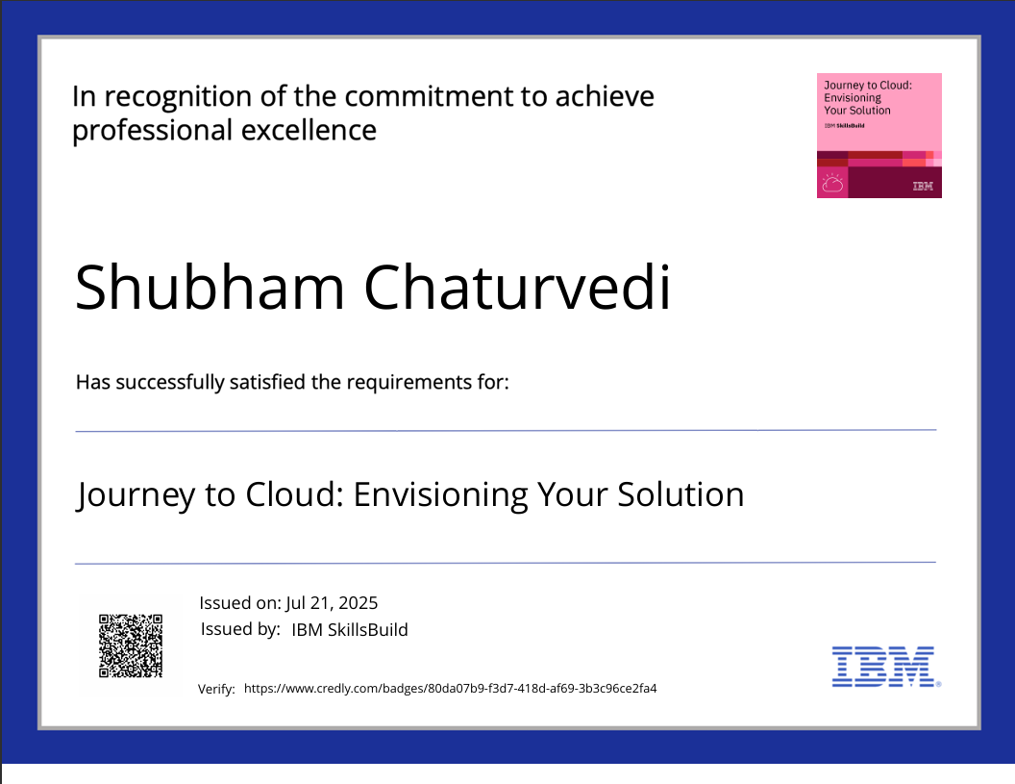
IBM Certifications

Slide 17
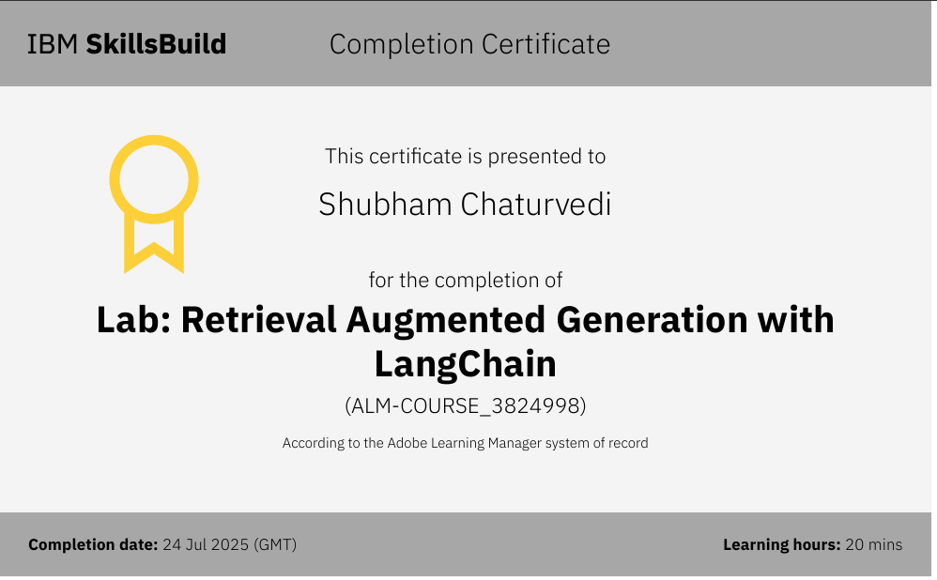
IBM Certifications

Slide 18
THANK YOU

